Slide 1

Classification Using KNN and SVM From Scratch
SVM vs KNN
Tools Used: Python, NumPy, scikit-learn (only for utilities)
-Ved Dhanokar
-ved.g37python@gmail.com

Slide 2
K-Nearest Neighbors (KNN) is a distance-based classification algorithm.
Logical Flow:
The algorithm stores all training data points
For a new (test) data point:
It calculates the distance to every training point
Identifies the K closest neighbors
The class label is decided by majority voting among neighbors
Important Characteristics:
No learning phase
Decision is made at prediction time
Heavily dependent on distance calculation

Slide 3
KNN – Key Logic
Distance Logic:
Similar data points lie closer in feature space
Euclidean distance is used to measure similarity
Decision Logic:
Smaller distance → higher influence
Class with highest frequency among neighbors wins
Strengths:
Simple and intuitive
Works well for small, clean datasets
Limitations:
Slow prediction for large datasets
Sensitive to noise and feature scaling

Slide 4
SVM – Core Working Logic
Logical Goal:
Find a boundary that separates classes
Maximize the distance (margin) between classes
Decision Logic:
Data points closest to the boundary are support vectors
Only these points influence the final model
Key Property:
The model focuses on global structure, not local neighbors

Slide 5
SVM – Optimization Logic
Mathematical Logic:
SVM tries to correctly classify points while keeping the margin wide
Misclassified or boundary-violating points are penalized
Learning Logic:
Uses an iterative optimization process
Adjusts weights and bias to:
reduce classification error
increase margin stability
Why This Works Well:
Prevents overfitting
Performs well in high-dimensional data

Slide 6
Comparison & Conclusion
Aspect | KNN | SVM
Learning Style | Lazy | Eager
Decision Basis | Local neighbors | Global margin
Training Cost | None | High
Prediction Speed | Slow | Fast
Noise Sensitivity | High | Low
KNN makes decisions based on local similarity
SVM makes decisions based on global optimization
Synthetic data helps clearly observe algorithm behavior
SVM is generally more stable and reliable

Slide 7
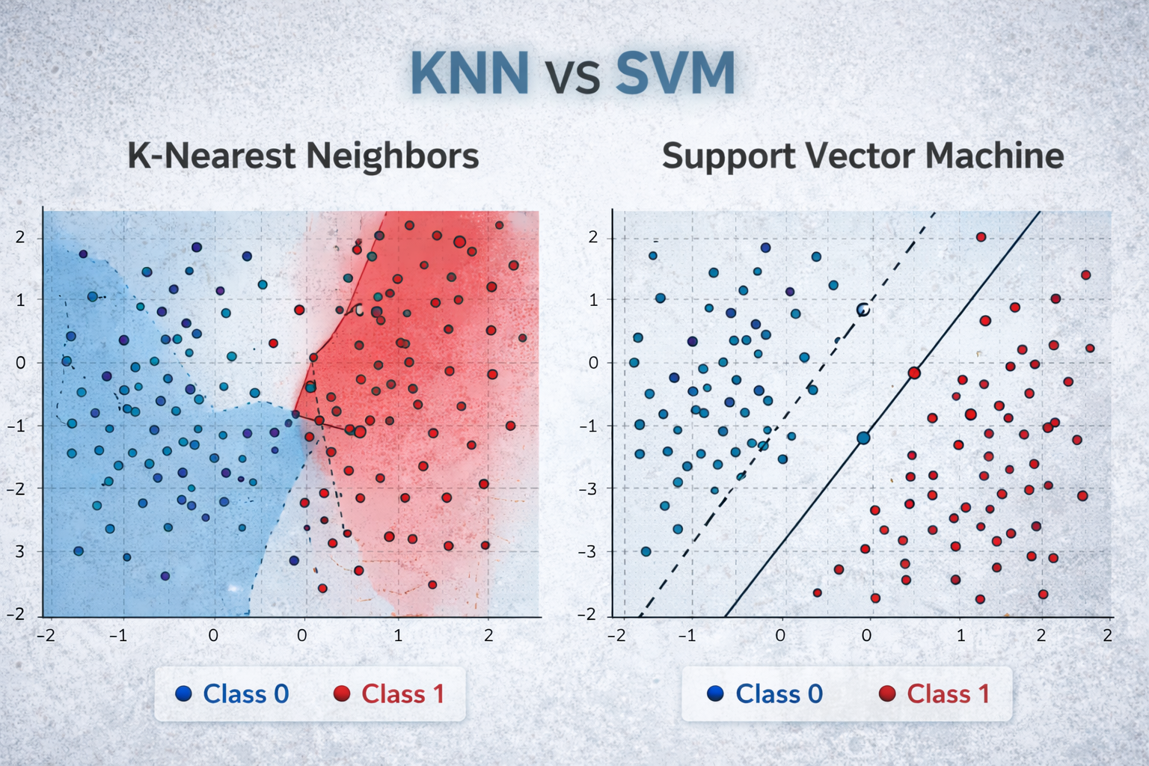
Thank You

